Slide 1
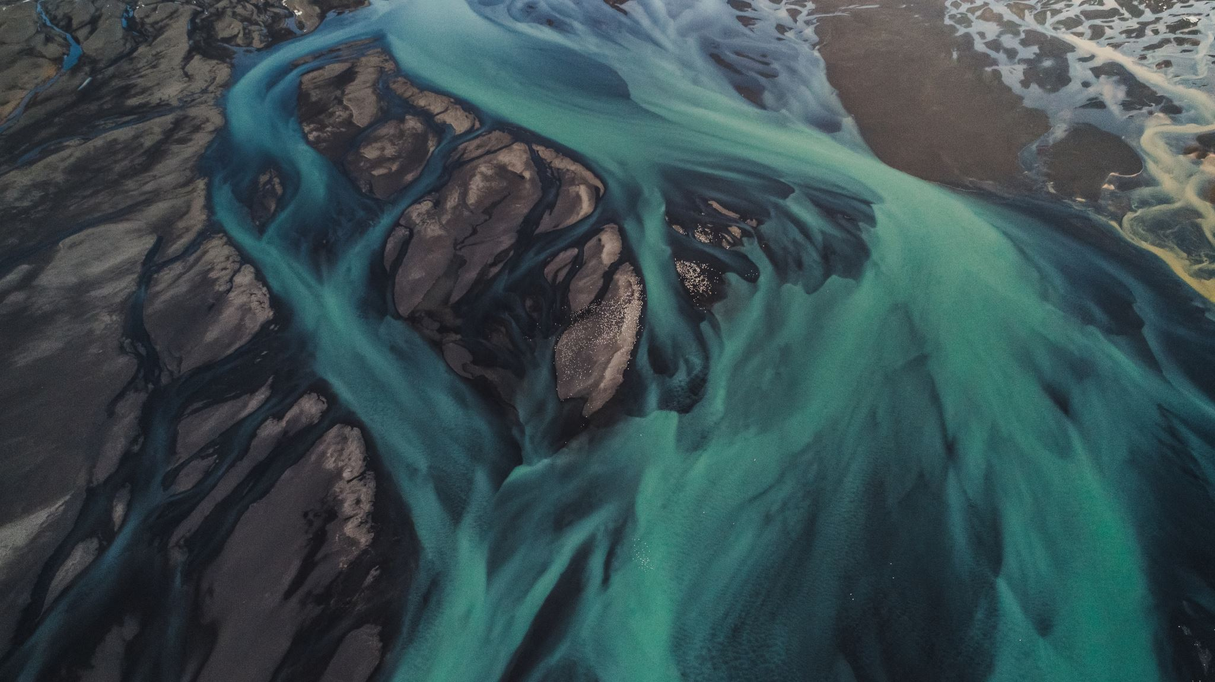
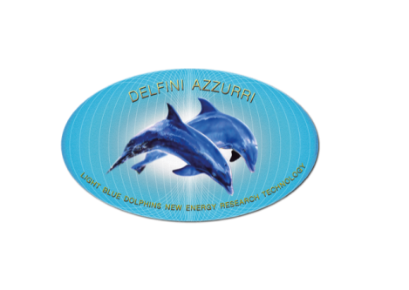

FDL TECHNOLOGY
Technology that Will Change the World

Slide 2
What are we doing to our environment?
One of the industries that is creating toxic pollution is the Mining Industry

Slide 3
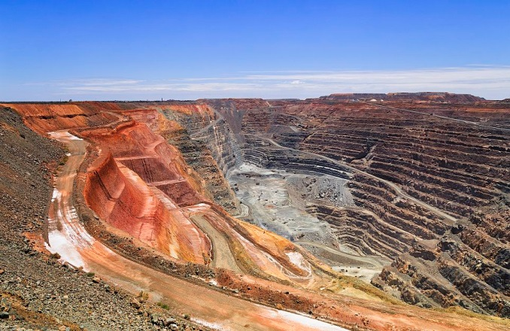
https://www.worldatlas.com/articles/what-is-the-environmental-impact-of-the-mining-industry.html
Environment
What Is The Environmental Impact Of The Mining Industry?
Mines are know to cause severe environmental problems
Mining adversely affects the environment by inducing loss of biodiversity, soil erosion, and contamination of surface water, groundwater, and soil. The leakage of chemicals from mining sites can also have detrimental effects on the health of the population living at or around the mining site.
Mining causes water pollution which includes metal contamination, increased sediment levels in streams, and acid mine drainage. Pollutants released from processing plants, tailing ponds, underground mines, waste-disposal areas, etc., act as the top sources of water pollution. High concentrations of toxic chemicals in water bodies pose a survival threat to aquatic flora and fauna and terrestrial species dependent on them for food. The acidic water released from metal mines or coal mines also drains into surface water or seeps below ground to acidify groundwater. The loss of normal pH of water can have disastrous effects on life sustained by such water. Toxins released through mining can wipe out entire populations of sensitive species.
http://www.yourarticlelibrary.com/environment/7-effects-of-mining-and-processing-of-mineral-resources-on-environment/28189
Pollution:
Mining operations often pollute the atmosphere, surface waters and ground water. Rainwater seeping through spoil heaps may become heavily contami­nated, acidic or turbid, with potentially devastating effects on nearby streams and rivers.
Trace elements (cadmium, cobalt, copper and others) when leached from mining wastes and concentrated in water, soil or plants, may be toxic or may cause diseases in people and other animals who consume contaminated water or plants, or who use the soil. Specially constructed ponds to collect run­off can help but cannot eliminate all problems.
Huge volumes of dust generated by explosions, transportation and processing may lead to the death of surrounding vegetation. Chemicals used in the extrac­tion processes are often highly polluting substances.

Slide 4
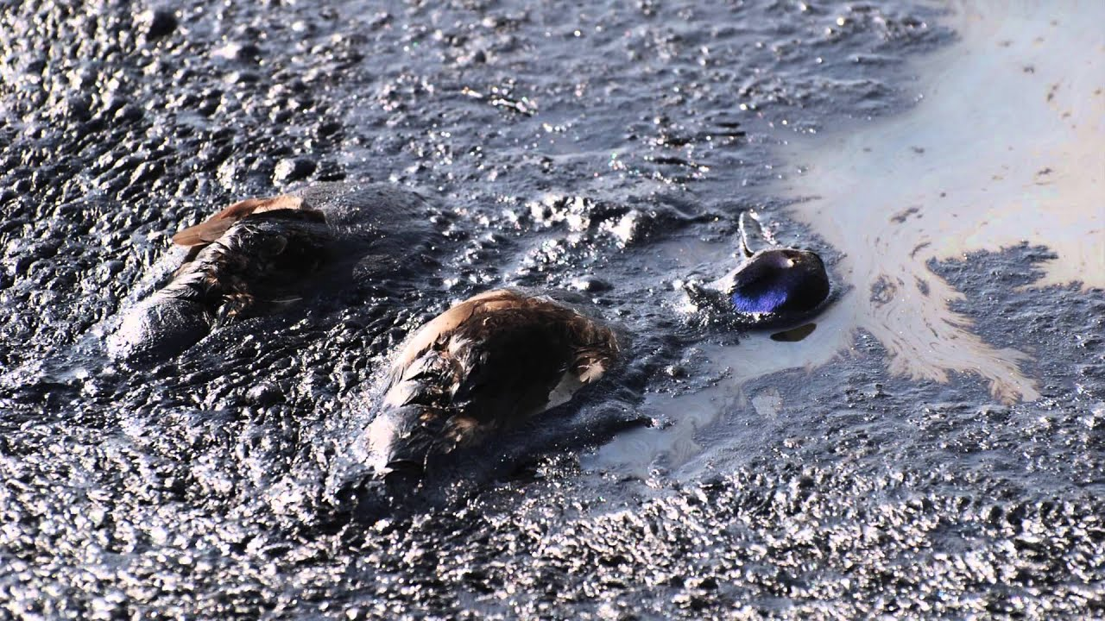
TAILINGS PONDS - WHERE MINING WASTES ARE DEPOSITED
Tailings are a type of rock waste from the mining industry. When a mineral product is mined, the valuable portion is usually embedded in a rock matrix called ore. Once the ore has been stripped of its valuable minerals, sometimes through the addition of chemicals, it is piled up into tailings. Tailings can reach immense proportions, appearing in the form of large hills (or sometimes ponds) on the landscape.
https://www.thoughtco.com/environmental-effects-of-mine-tailings-1204114
Tailings cause a variety of environmental problems:
Leaching. When rain falls on tailings, it leaches away materials that can create water pollution, for example, lead, arsenic, and mercury. Sulfuric acid is sometimes produced when water interacts with tailings, or it can be a by-product of ore processing. As a result, highly acidic water leaks from the tailings and disrupts aquatic life downstream. Tailings from copper and uranium mining often produce measurable levels of radioactivity
Leaks. Tailing ponds can be hundreds of acres in size, and in those cases, leaks into surface and ground waters are probably inevitable. The heavy metals, acids, and other contaminants end up polluting groundwater, lakes, streams, and rivers. Some very large ponds in Canada’s tar sands operations leak large amounts of tailings in the underlying soil, in the aquifer, and ultimately into the nearby Athabasca River.
Wildlife exposure. Migrating waterfowl has been known to land on tailing ponds, and in some cases with dramatic consequences. In 2008, about 1,600 ducks died after landing on a tar sands tailing pond in Alberta, contaminated by floating bitumen, a tar-like substance. However, simple deterrent measures can reduce that risk significantly.

Slide 5
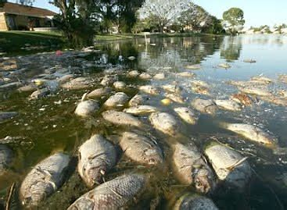
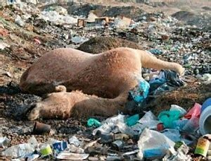
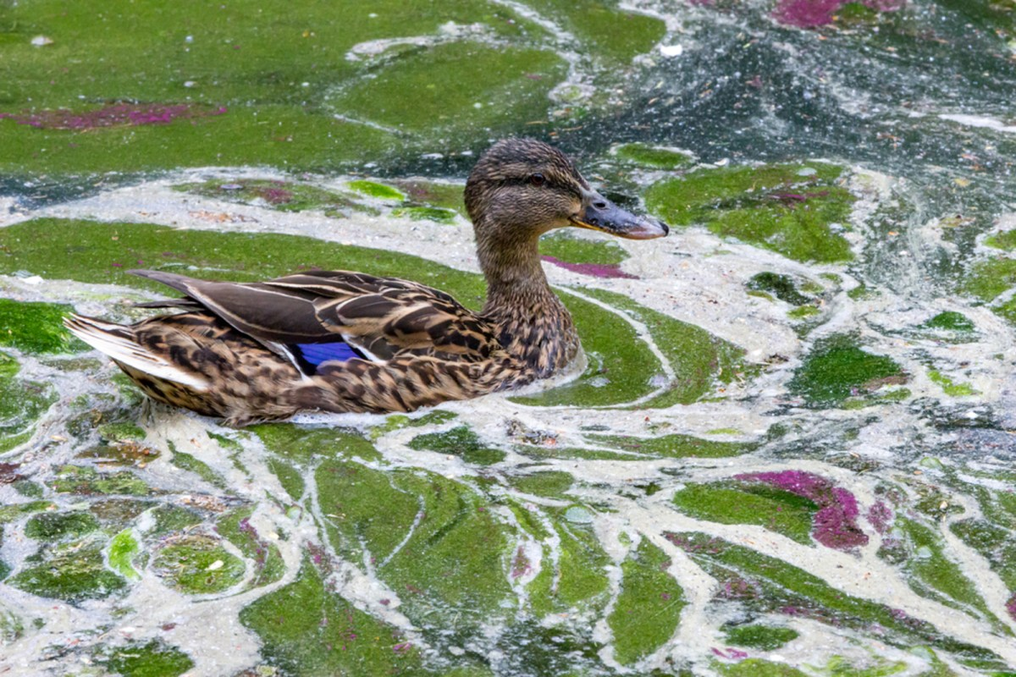
PRESENT MINING PRACTICES RESULT IN :
TOXIC CHEMICALS BEING RELEASED INTO OUR ENVIRONMENT CONTAMINATING OUR WORLD AND RESULTING IN THE RISK OF DISEASE /DEATH TO ALL LIVING CREATURES !

Slide 6
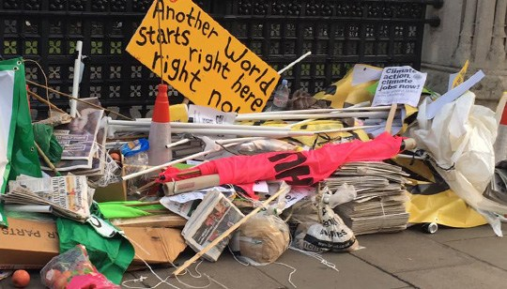
https://thehimalayantimes.com/world/un-environment-is-deadly-worsening-mess-but-not-hopeless/
United Nations: Environment is deadly, worsening mess, but not hopeless
Published: March 13, 2019
WASHINGTON: Earth is sick with multiple and worsening environmental ills killing millions of people yearly, a new UN report says . . . But it may not be too late.
“There is every reason to be hopeful,” report co-editors Joyeeta Gupta and Paul Ekins told The Associated Press in an email. “There is still time but the window is closing fast.”
The sixth Global Environment Outlook, released Wednesday at a UN conference in Nairobi, Kenya, painted a dire picture of a planet where environmental problems interact with each other to make things even more dangerous for people. It uses the word “risk” 561 times in a 740-page report.
The report concludes “unsustainable human activities globally have degraded the Earth’s ecosystems, endangering the ecological foundations of society.”
But the same document says changes in the way the world eats, buys things, gets its energy and handles its waste could help fix the problems.
The report is “a dramatic warning and a high-level road map for what must be done to prevent widespread disruption and even irreversible destruction of planetary life-support systems,” said University of Michigan environment dean Jonathan Overpeck, who wasn’t part of the report.

Slide 7



IT’S NOT TOO LATE BUT TIME IS RUNNING OUT
LET US SAVE THE PLANET FOR THE GENERATIONS TO COME!

Slide 8
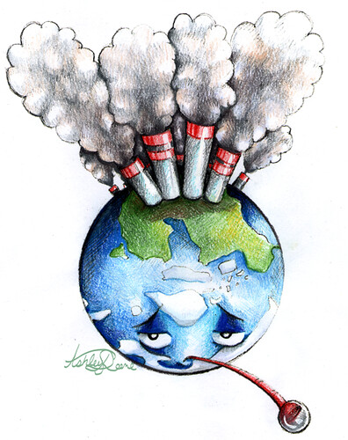
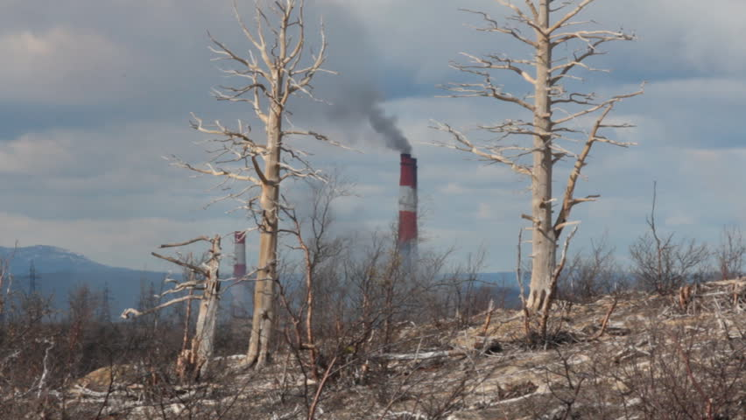
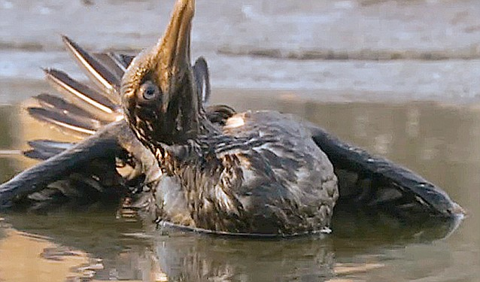


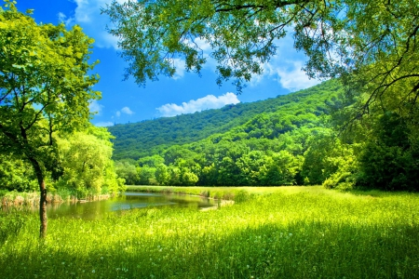
MANKIND IS KILLING THE PLANET
IT IS ONLY A MATTER OF TIME UNTIL ALL LIVING THINGS WILL SUFFER FROM MAN’S IRRESPONSIBLE BEHAVIOR
____________________________________________________________________________________________________________________________________
HOW CAN WE CHANGE THIS PROCESS and NO LONGER POLLUTE AND POISON OUR WORLD?
The Answer is :
FDL TECHNOLOGIES

Slide 9
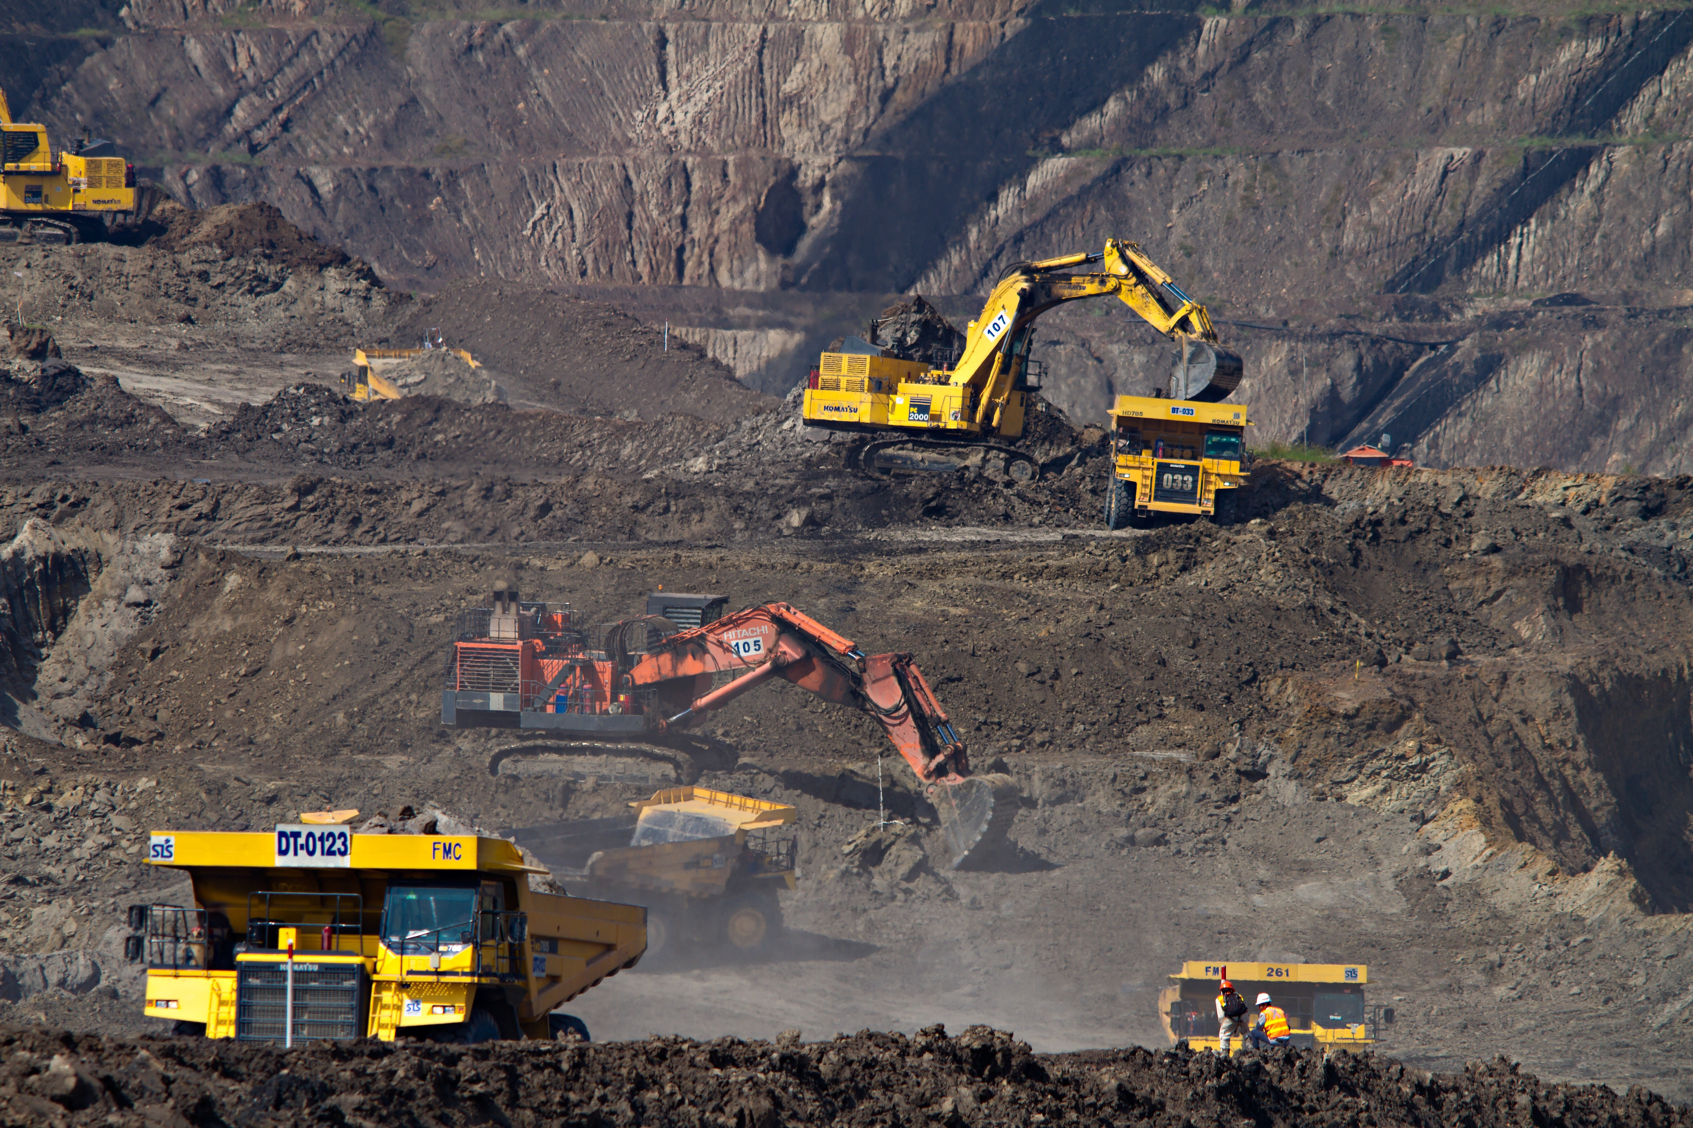
THE ALTERNATIVE TO CONVENTIONAL MINING PRACTICES & THE DESTRUCTION TO THE ENVIRONMENT T HAT THE MINING INDUSTRY IS CREATING . . . FDL!
FDL Technology is changing the milling era
Oc
FDL Technology / applications in the mining sector
FDL Electronic Imploder Mill -
An Environmentally Friendly Process
Using the FDL Process in mining, the final total yield is increased compared to traditional chemical methods and there will be no waste materials. The materials treated with the FDL technology become inert, dehydrated and sterile. Materials are totally pure, clean, free of insects or any other contaminant. Any byproduct of the process can create materials having the characteristic repulsion of fungi, algae, insects and other contaminants, thus improving the quality of life of people and protecting the environment!
9

Slide 10
FDL = Zero environmental impact with no chemicals and no waste
IT IS TIME to save the environment for our children.
The FDL implosion unit can replace existing mills for all applications known today, eliminating all the problems of mechanical mills and the actions that these activities have on the treated materials . . . without the addition of chemical components for processing, giving important benefits, economically and to the environment.
FDL Technology eliminates pathogens and odors.
No need for water, No need for chemicals.
FDL Technologies is a subsidiary of Thorus Holding Ltd

Slide 11
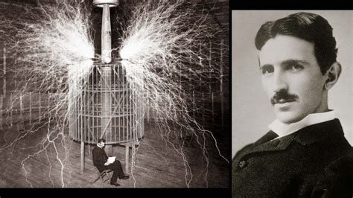
“THE PURPOSE OF AN INVENTOR IS TO ESSENTIALLY SAVE LIVES”
Nikola Tesla Nikola Tesla is one of the greatest inventors of history.
I do not think there is any thrill that can go through the human heart like that felt by the inventor as he sees some creation of the brain unfolding to success… such emotions make a man forget food, sleep, friends, love, everything. – Nikola Tesla
__Light Blue Dolphin S.r.l.
NEW ENERGY RESEARCH TECHNOLOGY
____________________

Slide 12
APPENDIX
https://www.worldatlas.com/articles/the-six-most-toxic-pollutants-in-the-world.html
Toxic Pollutants In The World
Pure Earth, a global leader in the cleanup of toxic pollutants in the environment, has compiled a list of the six pollutants that impose the biggest threats to human health. These pollutants together affect the health of 95 million individuals globally.
Lead
26 million people are threatened by lead pollution, as estimated by Pure Earth. Lead is a heavy metal that has been mined for use in a variety of products for household and industrial use. The metal is used in paints, pesticides, ammunition, pipes, car batteries, etc. Lead is also used to form alloys with other metals. Although the metal has been used for centuries, it was only in the recent decades that the ill effects of lead pollution have become known to people. Most of the world’s lead pollution is caused by the effluents released by a few industries like the mining industry. Over 800 sites across the world have been recognized as significant sources of lead pollution that threaten the health of the people living in those regions. Toxic levels of lead in the human body can trigger both chronic and acute health conditions. Exposure to lead has been associated with developmental defects in children and birth defects in newborns.
Radionuclides
According to Pure Earth, radionuclides are also one of the top six toxic threats in the world. Radionuclides occur in nature and are also artificially created by humans. These radioactive chemicals undergo decay to release radiation and radioactive particles which are highly dangerous to the health of humans and other living creatures. The time taken to decay varies with the nature of the radioactive material. It is thus necessary to handle and store radioactive waste with great caution until it decays completely. Under no circumstances should living creatures be exposed to such disintegrating radionuclides. Some of the biggest sources of radioactive waste are sourced from nuclear reactors and uranium mining activities. Although radionuclides can be responsibly used for a number of scientific and medical applications, they are most heavily used in the weapons production and energy industries. Pure Earth estimates that nearly 1 million people are threatened by radionuclide pollution in 91 sites across the world. Exposure to radioactivity triggers lethal diseases like cancers in people. Infant mortality and low-birth weights are common in populations exposed to radioactive pollutants. Other health effects of exposure to radiation include hair loss, fever, nausea, diarrhea, low blood pressure, disorientation, and even death.
Mercury
Nearly 19 million people in the world are at risk from exposure to mercury. The heavy metal occurs in elemental, organic, and inorganic forms. Mercury finds applications in several industries. Products such as dental fillings, thermometers, electrical switches, etc., use mercury. The process of extraction of gold also uses mercury. Both natural processes and industrial effluents are a source of mercury in the environment. 450 sites have been identified worldwide by the Toxic Sites Identification Program that relates to high levels of mercury pollution. Miners and other workers engaged in the gold mining and extraction industry are most at risk from mercury poisoning. Infants exposed to mercury might have developmental issues. Workplace associated mercury poisoning causes tremor, vision disorders, memory problems, and other health issues in the victims.

Slide 13

Cadmium
Cadmium has also been enlisted as one of the Top Six Toxic Threats 2015 by Pure Earth. An estimated 5 million people are exposed to cadmium globally. Cadmium is released by several industrial activities like mining, refining, smelting, etc. Other activities like waste incineration, fossil fuel burning, etc., also release cadmium into the environment. Acute and chronic exposure to toxic levels of cadmium could result in choking, vomiting, headaches, pulmonary and respiratory diseases, hepatotoxicity, renal failure, etc.
https://www.waterairpollution.org/causes-of-water-pollution/mining
Here are the kinds of mining activities with the most water pollution
Water pollution is caused by heavy metals or their leaching. It happens when certain metals such as cobalt, lead, copper, arsenic, zinc or cadmium, which can enter the food chain and significantly affect our health, establish contact with the nearby liquids. Those which are subject to leaching are washed away and reach even farther destinations.
Acid mine drainage is the thing which happens when the sulphides contained in some rock are exposed to air and generate H2SO4. If it is present in the liquid that we use for drinking or other activities, H2SO4 exercises a toxic harm on the aquatic creatures and cannot be removed easily. In the cases in which the concentration of acid in the water gets to a certain point, it causes the emergence of the proteobacteria Thiobacillus ferroxidans which, in turn, hastens the oxidation.
Provided there is exposure to air or aquatic resources, the leaching of sulphides will carry on. Hundred of years, even millennia may have to pass until they disappear from the local basins. However, the sulphides may also find their way to more distant rivers and lakes, making their condition poorer. The animals living there are damaged or killed off, and the people are prevented from the opportunity to use the aquatic basins as drinking or other useful resources.
Processing chemicals pollution. It is triggered after certain chemicals ,which the mining companies use so as to divide the core and the minerals, such as sulphuric acid or cyanide, escape the mine and find their way to the closely situated aquatic areas. These toxic components are detrimental to both people and animals.
Sedimentation and erosion. The mining activities are connected with various other processes. Infrastructure is necessary so as the mine to be reachable, pits are open for the purpose of extraction. This is not something which has no effect on the surrounding area. The soil and rocks are affected quite negatively. If there are appropriate supervision and prevention activities performed, the consequences may not be so serious. However, if not, the chemicals reach lakes and rivers and greatly diminish their quality. Riverbeds may be clogged by the sediment and the animal species and the vegetation may be deprived of access to oxygen.

Slide 14

https://www.worldwildlife.org/threats/pollution
Look at any ecosystem and there could be multiple forms of contamination—streams full of toxic chemicals from industrial processes, rivers overloaded with nutrients from farms, trash blowing away from landfills, city skies covered in smog. Even landscapes that appear pristine can experience the effects of pollution sources located hundreds or thousands of miles away.
Pollution may muddy landscapes, poison soils and waterways, or kill plants and animals. Humans are also regularly harmed by pollution. Long-term exposure to air pollution, for example, can lead to chronic respiratory disease, lung cancer and other diseases. Toxic chemicals that accumulate in top predators can make some species unsafe to eat. More than one billion people lack access to clean water and 2.4 billion don’t have adequate sanitation, putting them at risk of contracting deadly diseases.
TOXIC CHEMICALS
By 2000, the world’s chemical production had increased 400 fold since 1930. Chemicals have made much of modern life possible, but they’ve also contaminated landscapes around the world. They can travel great distances by air or accumulate in the bodies of animals and humans who absorb chemicals through the skin or ingest them in food or water. While some chemicals may be harmless, others can cause damage. Increasingly, there is particular concern lately about three types of chemicals: chemicals that persist in the environment and accumulate in the bodies of wildlife and people, endocrine disruptors that can interfere with hormones, and chemicals that cause cancer or damage DNA.
PREDATORS FULL OF POLLUTANTS
When toxic chemicals and metals enter the environment, organisms may absorb them through their skin or ingest them in their food or water. Animals higher in the food chain accumulate these toxins in higher and higher concentrations, a process called biomagnification. Top predators—including fish, birds, and mammals—can have much higher levels of these toxins in their bodies, making them more likely to experience the diseases, birth defects, genetic mutations, and other deleterious effects of these poisons.
OCEAN GARBAGE PATCHES
Plastics and other marine debris that can float may persist in the oceans for years, traveling the currents. Some of this material accumulates in the centers of ocean gyres, creating great garbage patches. The term “garbage patch” brings to mind floating islands of trash, but little of the debris can be seen on the surface. Garbage patches, instead, are areas where concentrations of flotsam and jetsam, mostly small pieces of plastic, are particularly high. This litter can distribute toxic chemicals throughout the oceans, snag and tear corals, and harm animals if they ingest pieces of plastic or become entangled in the debris.

Slide 15

https://wwf.panda.org/knowledge_hub/endangered_species/cetaceans/threats/pollution/
Pollution and toxics
Toxic chemicals and heavy metals in arctic ecosystems work their way up through the food chain.
Studies of whale and dolphin tissues from around the world show significant levels of persistent organic pollutants (POPs) and endocrine disrupting chemicals (EDCs). In some cases, levels of these chemicals are high enough to cause damage to both reproductive and immune systems.
Mining, metal processing, burning fossil fuels and dumping waste all increase the level of metals transported by ocean and air currents to the Arctic. They do not degrade. In fact microorganisms convert inorganic mercury, for example, into methyl mercury, a fat-soluble molecule that easily passes through cell membranes, accumulates in animals, and spreads throughout the food web.
For more on toxics in the Arctic, visit the The Arctic Monitoring and Assessment Programmed (AMAP) website.
Mercury is a nerve toxin that has a major impact on the brain, particularly in growing fetus and juvenile. Mercury can also damage reproduction in mammals by interfering with sperm formation. Neurological and reproductive effects have also been seen in birds. In fish, its effects also include a decreased sense of smell, damage to gills, blindness and changes in the ability to absorb nutrients in the intestines.
https://www.rt.com/news/cyanide-gold-romania-protest-585/
Cyanide pollution fears: Thousands of Romanians protest ‘biggest in Europe’ gold mine
Massive protests are gripping Romania against the government’s controversial decision to pave the way for a Canadian firm to build Europe’s largest opencast gold mine – which many fear may lead to an environmental disaster.
Cyanide is widely used by the mining industry to assist in the extraction of gold from ore. However, there are two main risks associated with the process: the possibility of cyanide leaching into soil and groundwater at toxic concentrations, and catastrophic spills which may lead to flooding an ecosystem with toxic levels of cyanide.
Protesters march during the eight day of demonstrations in Bucharest against the Rosia Montana Gold Corporation (RMGC), a Canadian gold mine project using cyanide

